Slide 1






Wake County
Monthly Agency Administrator Meeting
April 2025

Slide 2

ICE BREAKER!
Imagine you could teleport anywhere.
Where is the first place you would go?

Slide 3
Agenda
Duplicate Clients
HIC/PIT Updates
Exits and Destinations

Slide 4

Duplicate Clients

Slide 5
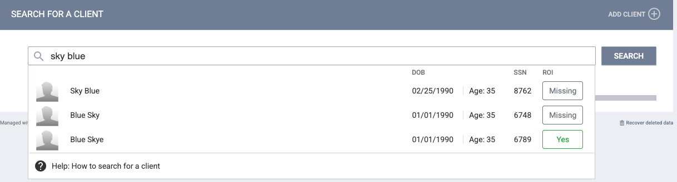

What is Duplicate Data?
Duplicate client records occur when two or more client records are created for the same client.
A duplicate record can have the same information as another client record:
  Name
  Date of Birth
  Social Security Number

Slide 6

Identifying Duplicate Clients
Identify which client record should be merged, and which client record should be retained.
Determine what information needs to be transferred to the retained profile. This could be services, program enrollments, files, assessments, etc.
Client profile data from the retained record takes precedence over profile data from the merged record!

Slide 7

How to correct Duplicate Client Data
Once you have determined what data to retain, you can contact Bitfocus support through the chat module, phone, or email.
Include the Unique Identifiers (UIDs) for which client to retain and which to merge, and what data to transfer to the retained profile, if any

Slide 8

HIC/PIT Updates

Slide 9
HIC/PIT Updates
HIC/PIT submission to HUD – Coming Soon!
Continue Data Quality cleanup.
Schedule time with Bitfocus.
Respond to outreach emails from Wake County and Bitfocus

Slide 10

Exits and Destinations

Slide 11



Why is Exit and Destination Data Important?
Determines the effectiveness of your program and gaps in service | Documenting episodes of homelessness that can support clients through the Coordinated Entry process. | Directly impacts the goals of System Performance Measures and reporting.

Slide 12

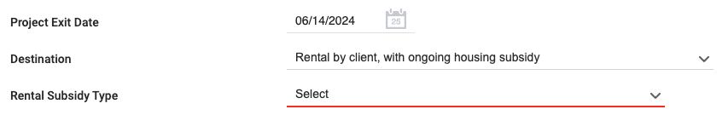
Exit Destination
Exit destination is critical in determining program effectiveness and identifying service gaps in the system.
”Where will the client be staying after exiting from the program (that night)?
Homeless providers are empowered to use their best judgment and logic to fill data gaps due to unexpected program departures.
  **Conclusions must be based on first-hand knowledge or conversations with the client**

Slide 13
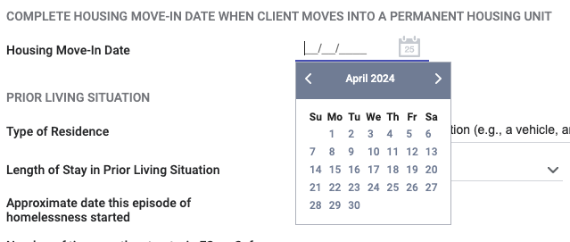
Housing Move-In Date
The housing move-in date refers to the data a household will physically begin sleeping in their new permanent unit.
If no move-in date is logged, the client will appear homeless in all reporting.
If the move-in date is before the program start date or after the program end date, the move-in date cannot be accredited to the program.
The move-in date should not overlap with other housed or sheltered dates.

Slide 14
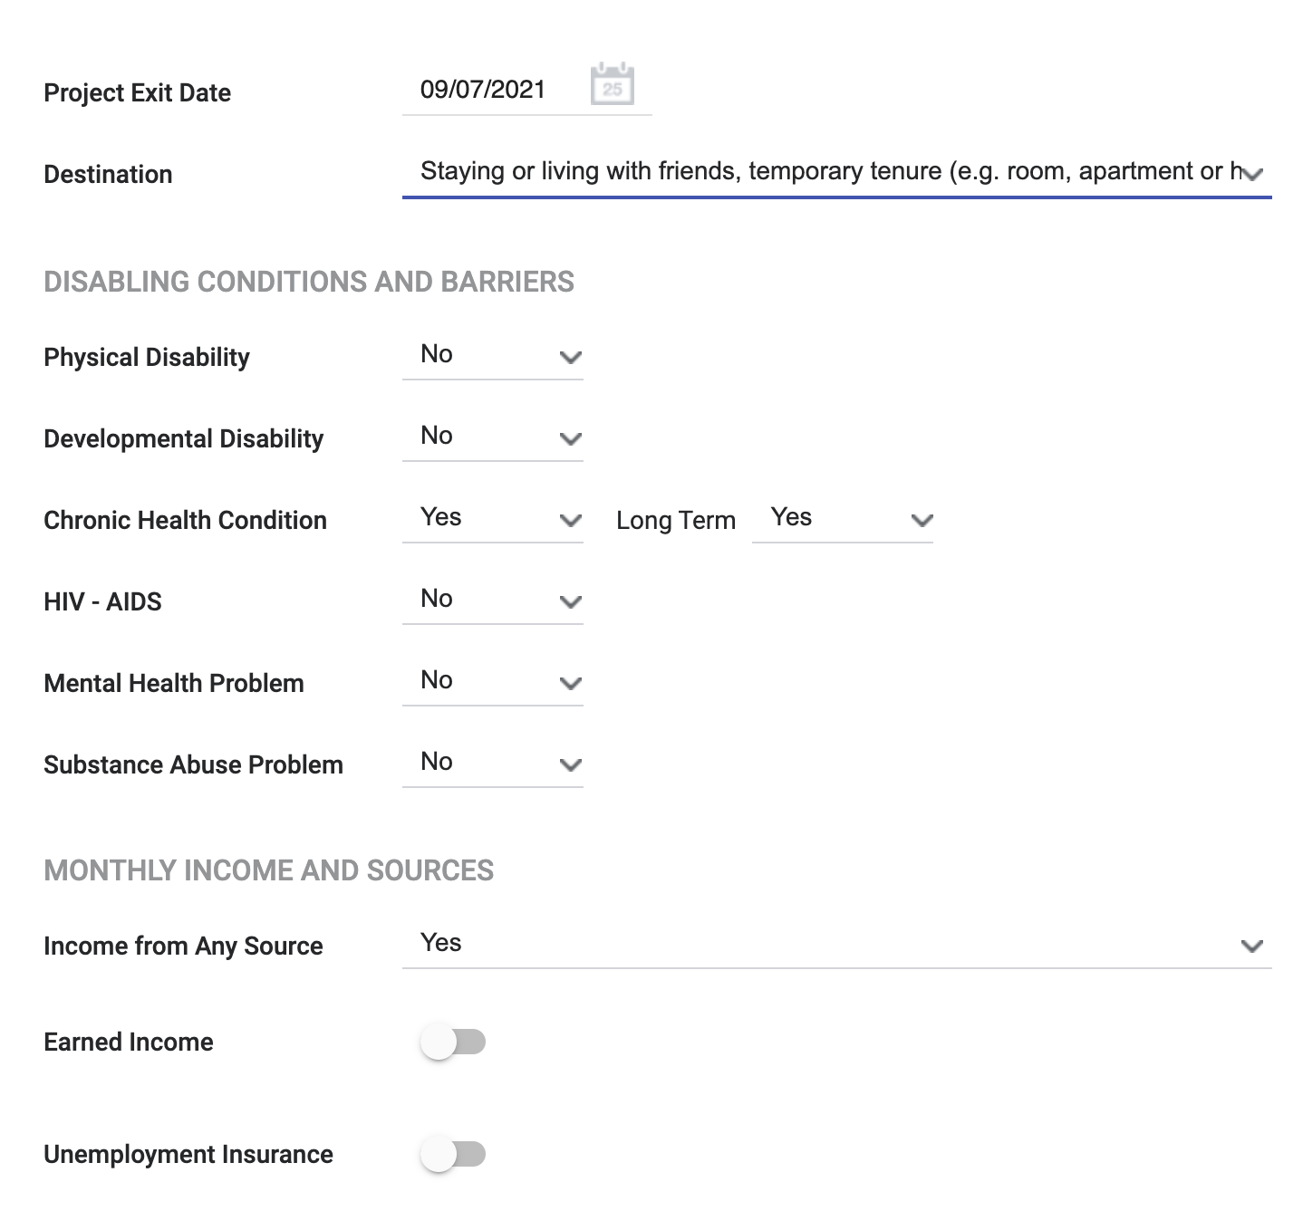
Exiting clients from a program
Identify where the client will be staying after being exited from your program (that night).
Enrollment data will auto-populate to the exit screen except the Exit Destination
The clients’ Exit Destination must be entered at the time they are being exited from the program.
Data Not Collected, No Exit Interview Completed, and Other are considered “missing data”– avoid using when possible
Confidential and Proprietary ⎢ © Copyright 2022 Bitfocus, Inc., All Rights Reserved.

Slide 15

HELPFUL REPORTS

Slide 16
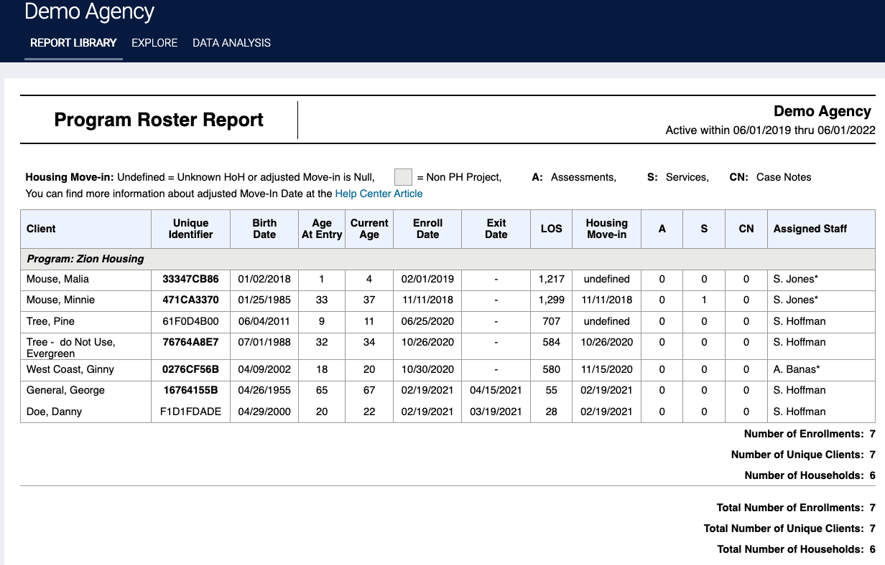
[GNRL – 106] Program roster report
This program-based report lists program stay information for selected programs and status according to specified report dates.

Slide 17
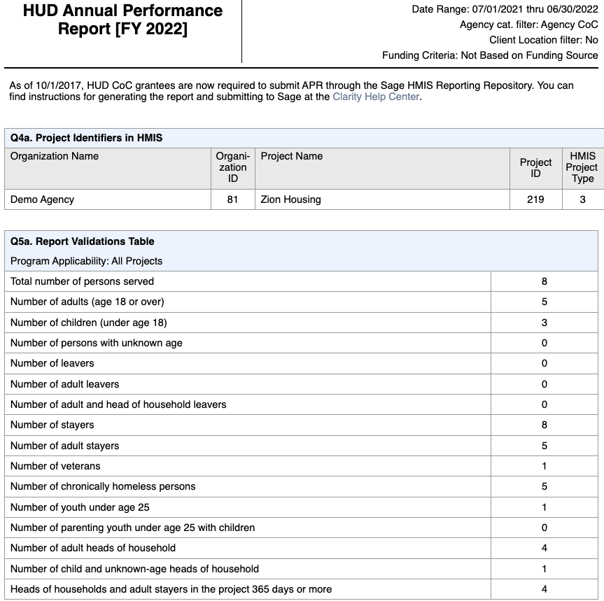
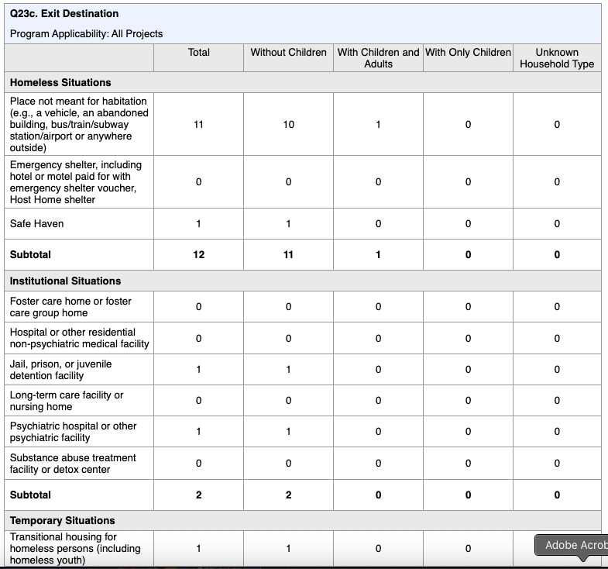
[HUDX– 227] Annual Performance Report [FY 2024]
A breakdown of data for clients served in a program(s).
Includes Data Quality Issues
Exit Destinations by Category/Destination
Lots of client data and program performance!

Slide 18
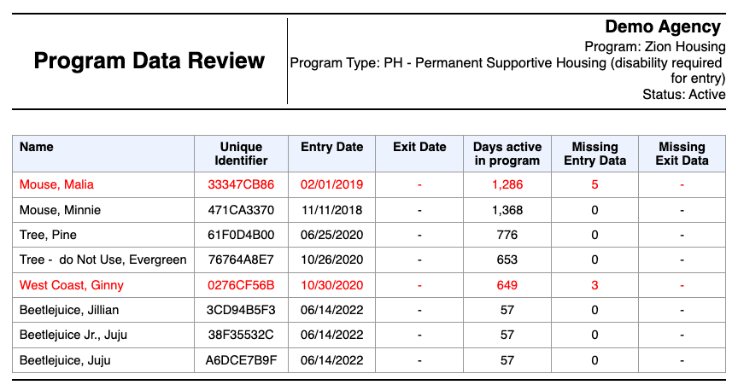
[DQXX – 102] Program Data Review
This program enrollment-based report utilizes information from both the enrollment screen and, if applicable, the exit screen.

Slide 19

Questions?

Slide 20

For Support:
Bitfocus Help Desk Support:
Email: support@bitfocus.com
Phone: 800.594.9854 x1
Bitfocus Community Administrators
Email: wake-admin@bitfocus.com

