Slide 1
Wake County Agency Administrator Meeting
May 2025

Slide 2
Ice Breaker! What was the first album you ever bought? (Was it a record, cassette, 8-Track, CD, etc.?)
Please let us know your:
Name
Agency
Role

Slide 3
ANNOUNCEMENTS

Slide 4
Data Quality Checks
Run reports regularly
Correct the data if you run into data quality issues.
Work with staff to improve data quality.
Update information as needed.

Slide 5
Annual Assessments
HUD Says:
Annual Assessment– Data elements required for collection at annual assessment must be entered with an ‘Information Date’ of no more than 30 days before or after the anniversary of the Head of Household’s ‘Project Start Date’, regardless of the date of the most recent ‘update’ or any other ‘annual assessment’.
30 Days Before
30 Days After
Anniversary Date

Slide 6
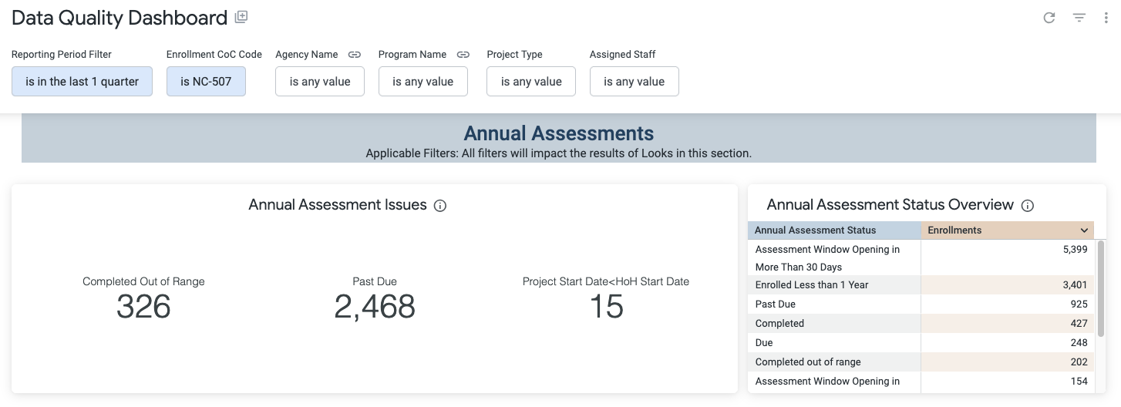
Annual Assessments

Slide 7
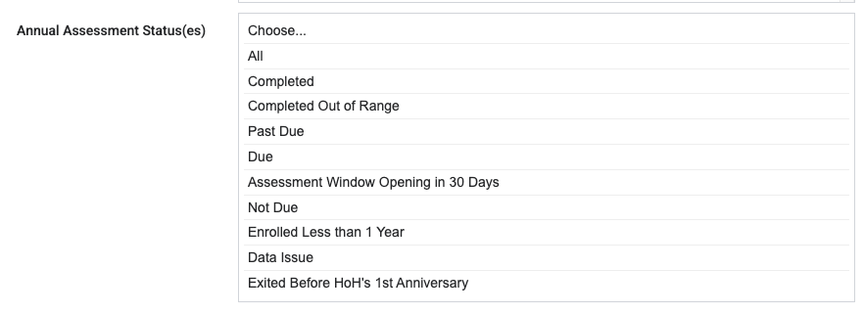
NEW Report!
[GNRL-409] Annual Assessment Overview
(Program Based Reports)
Tracks client progress regarding their annual assessments.
A comprehensive look into the timely completion of assessments.
Flag overdue assessments and data-related issues to assist with data quality, compliance, and monitoring.

Slide 8
[GNRL-409] Annual Assessment Overview

Slide 9
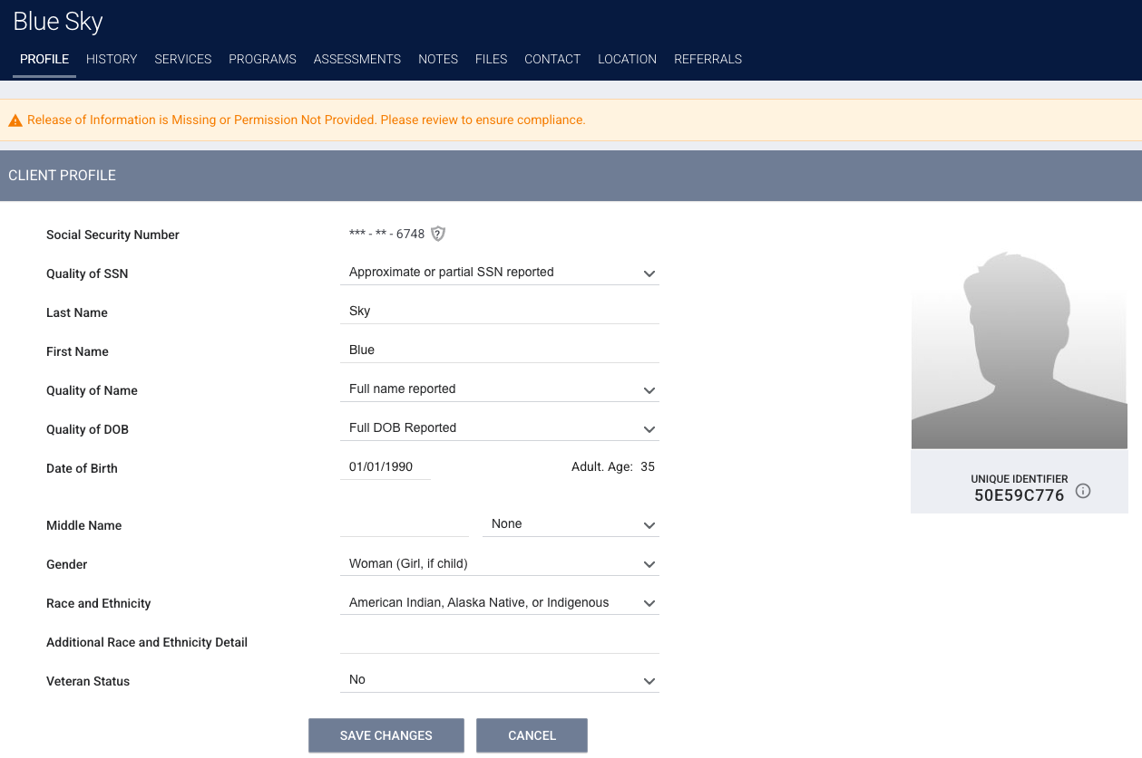
Universal Data Elements Data Quality
What are Universal Data Elements (UDE)?
Social Security Number (SSN)
Name
Date of Birth (DOB)
Race and Ethnicity
Gender
Veteran Status
Disability
Income & Sources
Head of Household
Prior Living Situation

Slide 10
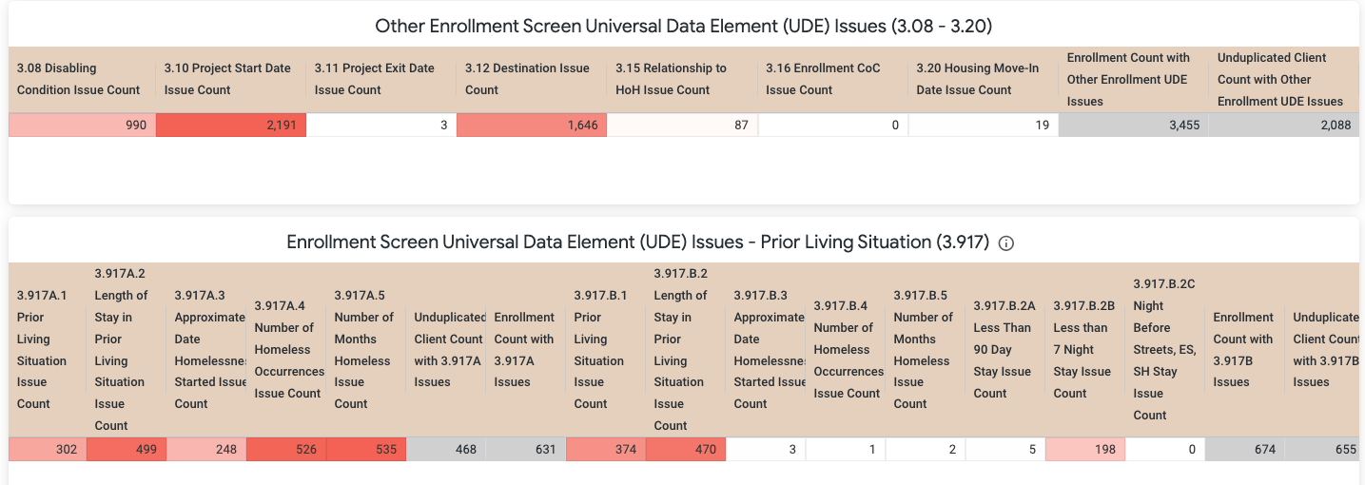
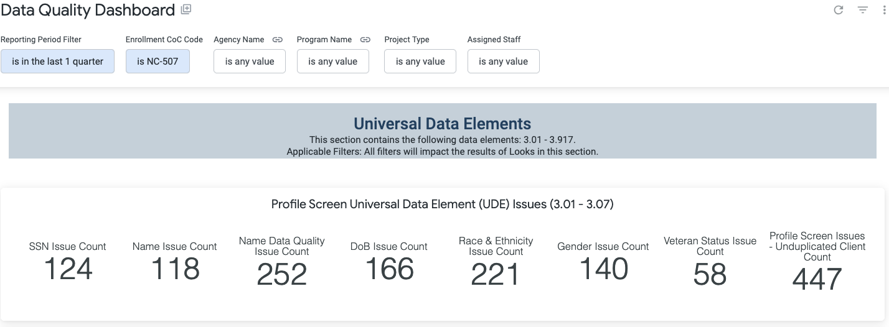
Universal Data Elements Data Quality

Slide 11
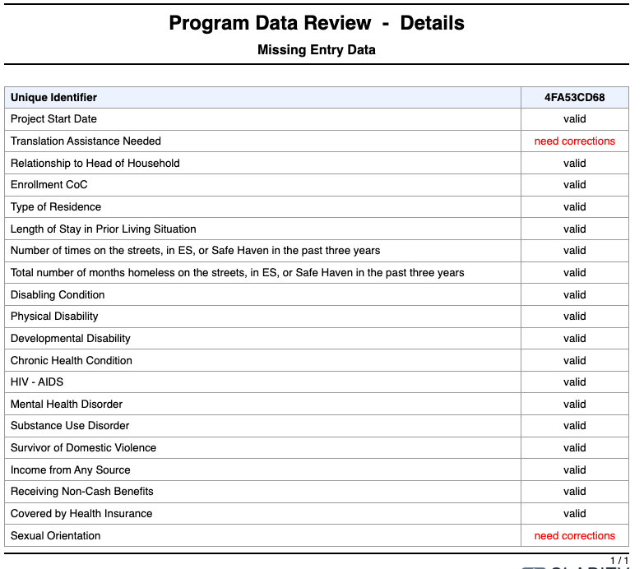
Helpful Reports
[DQXX-102] Program Data Review
(Data Quality Folder)

Slide 12
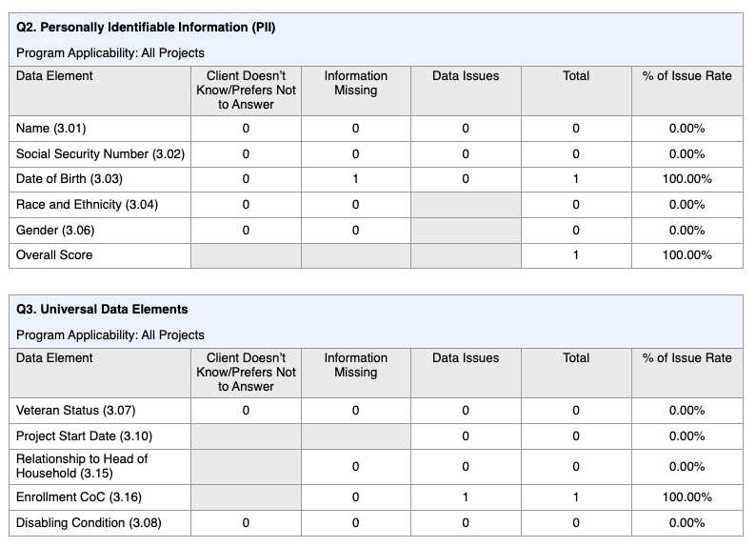
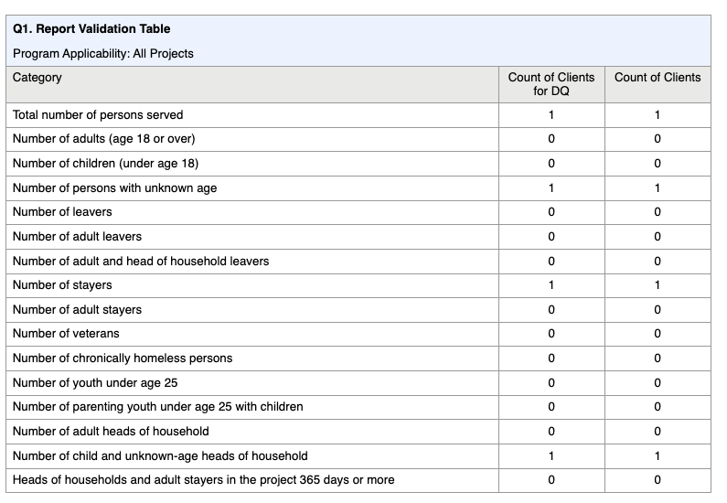
Helpful Reports
[HUDX-225] HMIS Data Quality Report [FY 2024]
(HUD Reports Folder)

Slide 13
Questions?

Slide 14
For Support:
Bitfocus Help Desk Support:
Email: support@bitfocus.com
Phone: 800.594.9854 x1
Bitfocus Community Administrators
Email: wake-admin@bitfocus.com

